Slide 1

Contents
Overview
State diagrams versus flowcharts

Slide 2
State Diagrams
What is a State Diagram
A state diagram is a type of diagram used in computer science and related fields to describe the behavior of systems. State diagrams require that the system described is composed of a finite number of states; sometimes, this is indeed the case, while at other times this is a reasonable abstraction. Many forms of state diagrams exist, which differ slightly and have different semantics.
Notes:
QuickStarter has created an outline to help you get started on your presentation. Some slides include information here in the notes to provide additional topics for you to research.

Slide 3
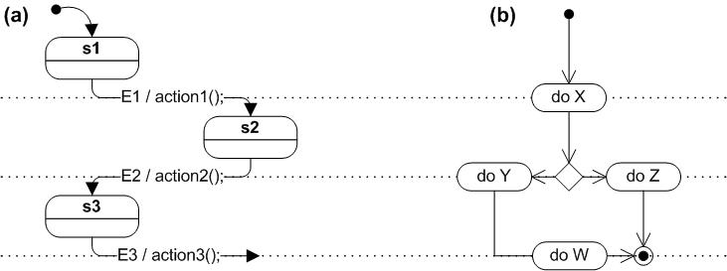
State diagrams versus flowcharts
A flowchart illustrates processes that are executed in the system that change the state of objects. A state diagram shows the actual changes in state, not the processes or commands that created those changes.

Slide 4
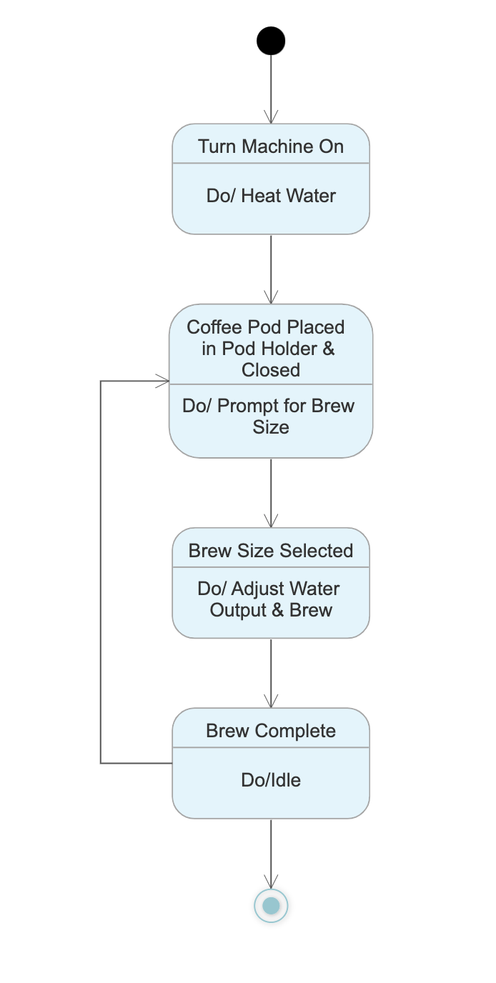
Coffee Machine State Diagram

Slide 5
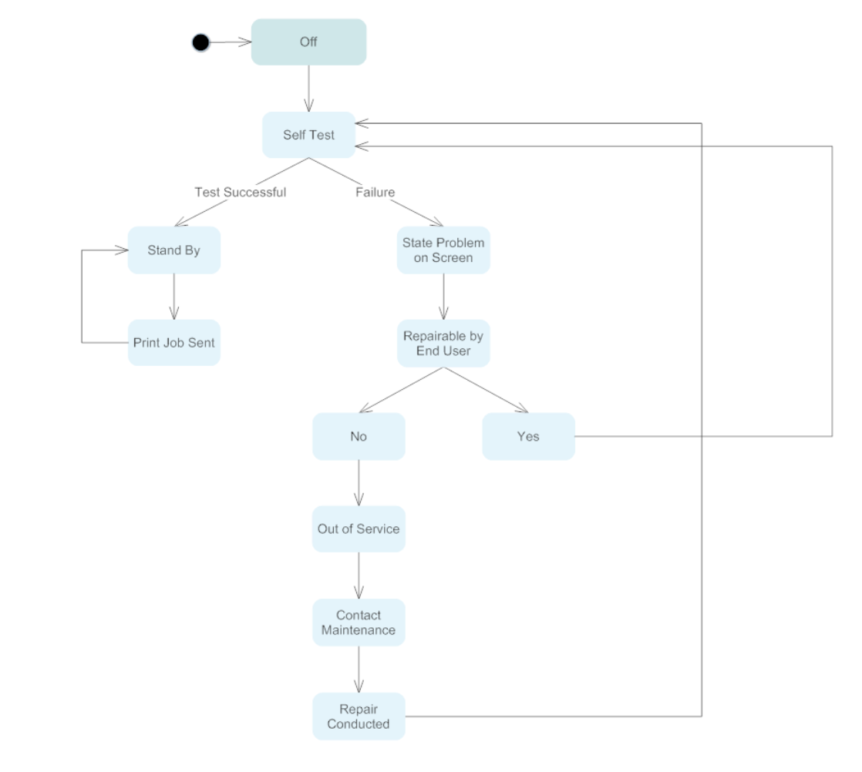
Printer State Diagram

